Slide 1


EDA of IPL Matches
2008-2018
Notes:
In this presentation we will look into results and stats derived by doing Exploratory Data Analysis on data of IPL matches played between 2008-2018.

Slide 2
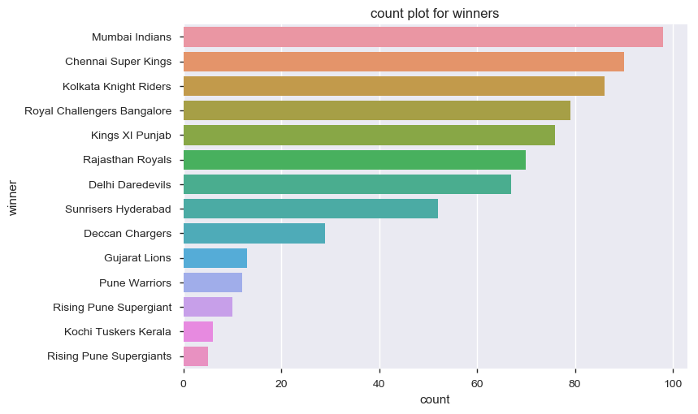
Which team has won the maximum matches?
Notes:
This bar charts shows total number of matches won by any team. From chart we can see that Mumbai Indians is top on list.

Slide 3
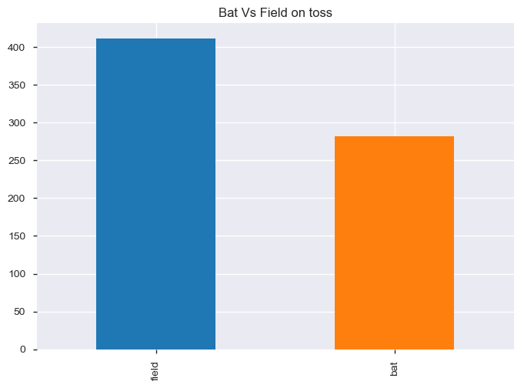
Toss Decision
Notes:
In this slide we have plot toss decision taken by any team on winning the toss. In IPL most teams choose field over bat.

Slide 4
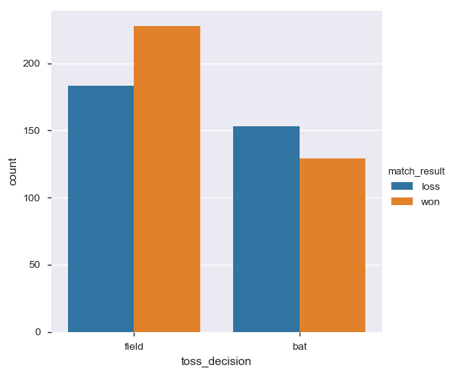
Bat First Vs Field First
Notes:
This bar graph show that team who choose field first have more number of winnings than who choose bat first.

Slide 5
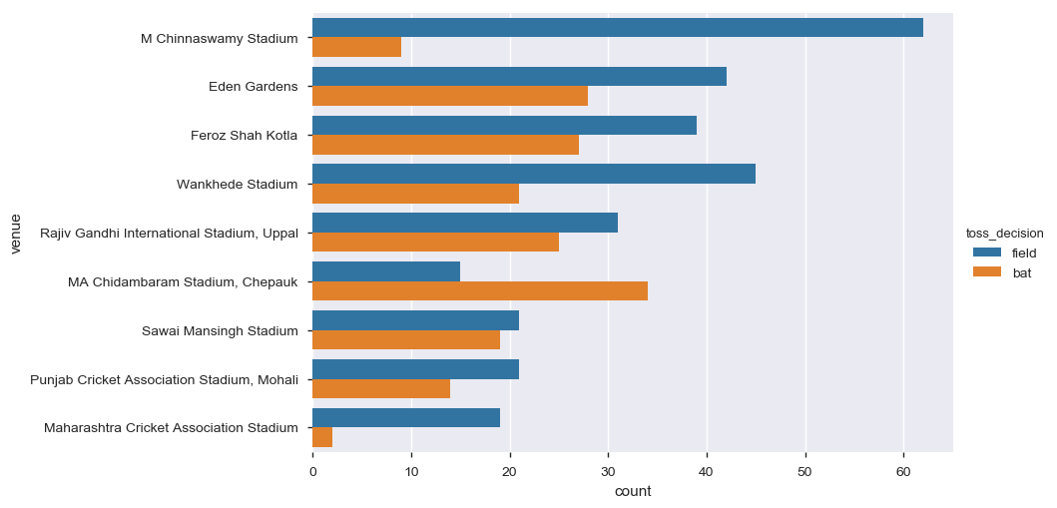
Toss Decision vs Venus
Notes:
If we look at toss decision based on stadium then in almost every stadium except MA Chidambaram choose field first on toss winning.

Slide 6
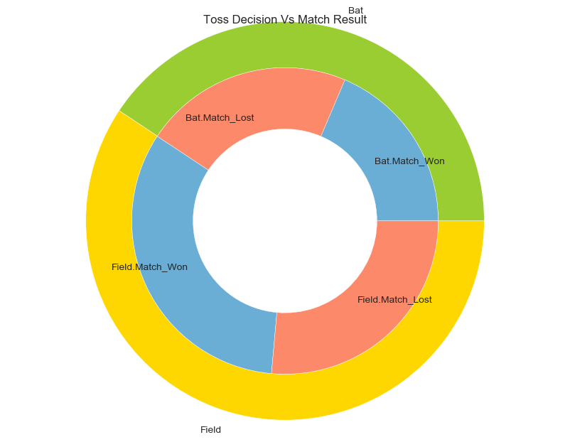
Toss Decision Vs Match Result
Notes:
This donut chart depicts that on toss more teams choose field first and also team who choose field first have more number of wins than who choose bat first.

Slide 7
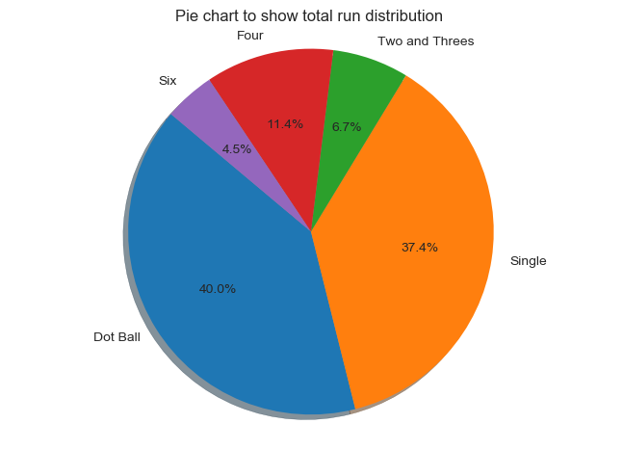
Run Scored Vs Delivery
Notes:
This pie chart is distribution of runs scored on each deliveries . We can see that 40 % of deliveries played as dot , and 37% singles have taken.

Slide 8
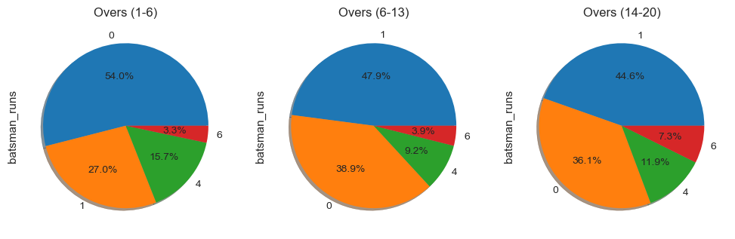
Run Scored distribution Vs Over Intervals
Notes:
In these pie chart, we have distributed run distribution based on interval of overs. In first 1-6 overs of powerplay 54% deliveries played as dot which is maximum compared to other intervals as batsman try to build his inning. Also % of hitting fours is also maximum here which stats batsman try to play safe shots . In over between 14-20 , 7.3% sixes gone hit which clearly says that players go for power hitting in last overs.

Slide 9
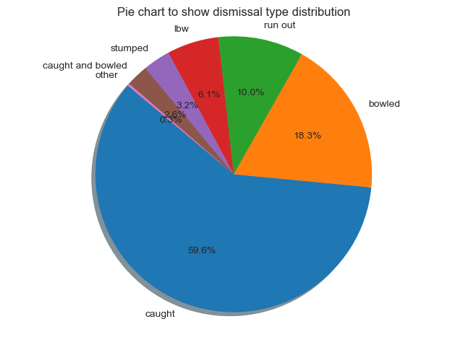
Most frequent Dismissal Type
Notes:
This is distribution of batsman type of dismissal. From this we can see that most batsman get caught out which says that batsman go for power hitting in IPL.

Slide 10
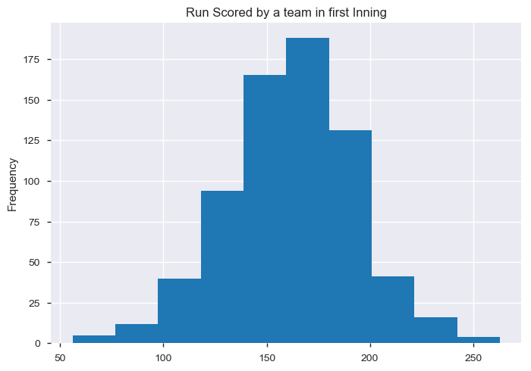
Average Target given by teams
Notes:
This is distribution of run scored in first inning. We can see that average target given by any team is mostly between 150 – 200.

